Slide 1

SoftUni memory game

Slide 2

Teodor Penev
Nicollette Karaivanova
Lyubomir Viktorov
Svilen Tyutyunev
Georgi Marinov

Slide 3
SoftUni memory – main game idea
You have 12 reversed cards
Flip one by one card till you find match
If it is not correct the 2 card flipover
Try to find all 6 trainers

Slide 4
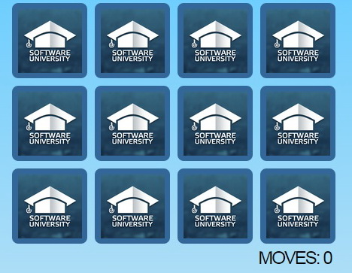
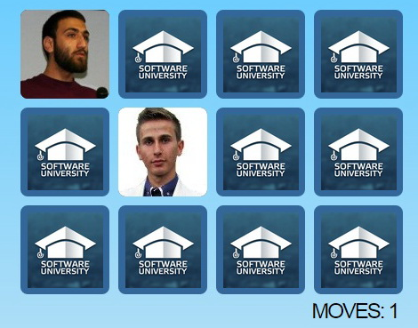
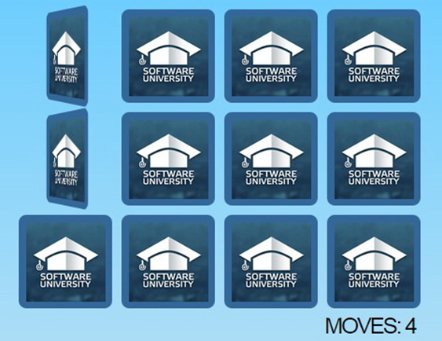
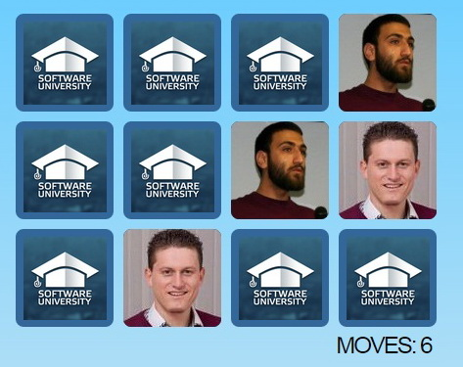
Demo

Slide 5
Contributions: 1. Ideas gathering - whole team 2. Git Repository - Teodor 3. First basic version - whole team 4. HTML structure –Teodor, Svilen 5. CSS design – Lyubomir, Georgi, Nicollette 6. JS basics functionality – whole team 7. Timer system – Lyubomir 8. Score system - Lybomir, Georgi, Nicollette 9. Sounds - Svilen 10. Testing - whole team 11. Presentation – Svilen, Teodor

